Slide 1
Basic Radio Usage
AWIN Network Support

Slide 2
Table of Contents
What is AWIN?
What is P25?
What are Radios?
Why are Radios Important?
Basic Radio Terminology
Radio Etiquette
How to Use a Radio (Handheld/Portable)
Hands-On
Questions

Slide 3
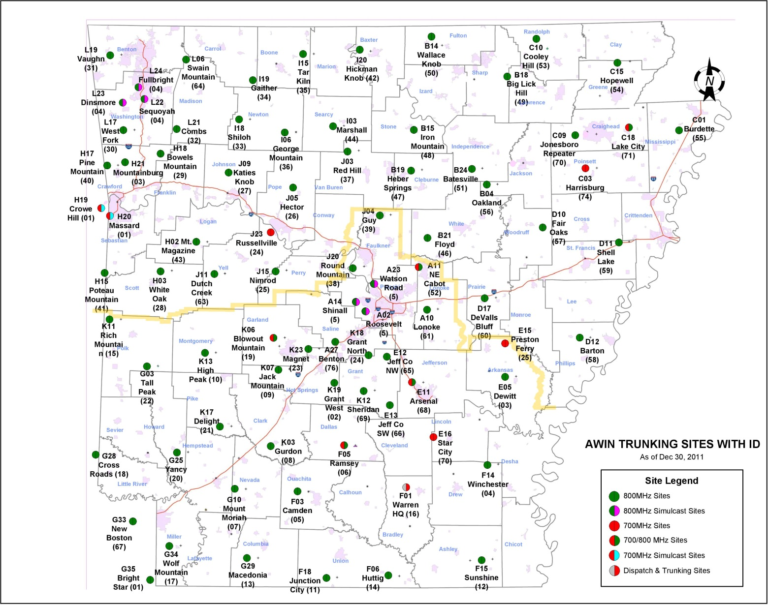
What is AWIN?

Slide 4
What is AWIN?
The statewide, multiple site, digital 700/800 MHz trunked communications system using the P25 Standard.
AWIN provides statewide operations, within the coverage area of the system for public service entities.

Slide 5
What is AWIN?
AWIN provides a reliable, statewide means of communication for the state’s first responders. The AWIN system consists of over 100 tower sites and over 27,000 authorized radios.
AWIN is monitored 24/7/365 to ensure that it is available whenever the first responder needs it.

Slide 6
What is P25?
The standard for the manufacturing of interoperable digital 2-way wireless communications products.
All P25 Equipment:
Must demonstrate compliance
Meet the needs of public safety
Be Interoperable with other P25 Equipment

Slide 7
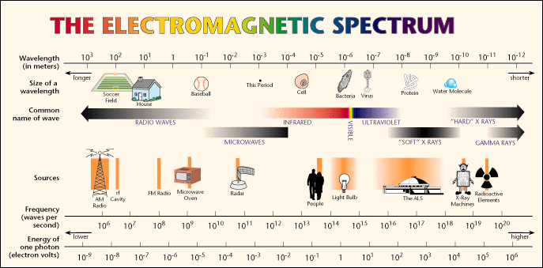
What are Radios?
The definition of radio is:
“The transmission and reception of electromagnetic waves of radio frequency, especially those carrying sound messages”

Slide 8
What are Radios?
The electromagnetic spectrum consists of everything from:
X-Rays
UV Light
Infrared Light
Visible Light
Microwaves
FM Radio
AM radio

Slide 9
What are Radios?
As for AWIN – We fall into the UHF (Ultra High Frequency) part of the spectrum.
Specifically we are in the 700 and 800 MHz bands.

Slide 10
Why are Radios Important?
Good, reliable communication save lives.
All first responders/emergency personnel have radios or access to radios, either through AWIN, through their own radio system, or another agency.

Slide 11
Why are Radios Important?
What about cell phones?
Cell phones are not public safety grade (yet).
Cell phones do not have to comply to P25 or other public safety standards (yet).
Cell phone towers tend to be the first to get congested in an emergency. Usually due to call volume/wireless internet usage.

Slide 12
Why are Radios Important?
What about cell phones?
A call to another person on a cell phone does not broadcast to multiple individuals.
Calls to 911 on a cell phone might not reach your local 911 center. They could roll-over to another county, jurisdiction, or (if you are near the state border) another state.
Emergency calls on cell phones do not have priority on cell networks (yet).

Slide 13
Basic Radio Terminology
Radio
Radio ID/AWIN ID
Radio Alias
Tower
Coverage/Coverage Area
Talk Group
Mutual Aid Channel (MAC)
Talk Group Dragging
Push to Talk (PTT)
Wide Area Trunking/Trunking

Slide 14
Basic Radio Terminology
Radio
The device assigned to you from your department that is used for emergency communications.
Can be:
Handheld/Portable
Mobile
Base Station/Console

Slide 15
Basic Radio Terminology
Radio ID/AWIN ID
Unique ID (usually 7 digits) that allows your radio to be on AWIN.
These have to be approved and applied for through AWIN.
Each radio must have a unique ID – Duplicate IDs are not allowed and can hurt communications.

Slide 16
Basic Radio Terminology
Radio Alias
This is what you want your radio to show when you make a call on it.
Examples are:
SALI S 202m
Means – Saline County Sheriff’s Office Car# 202 (Mobile Radio)
SALI S 15p
Means – Saline County Sheriff’s Office Radio# 15 (Portable)
PULA E 1p
Means – Pulaski County Office Of Emergency Management Radio# 1 (Portable)

Slide 17
Basic Radio Terminology
Tower
The physical location where the signal your radio receives is broadcast from.
Each tower has 3 identifiers on it.
A name (I.E. Roosevelt, White Oak, Lonoke)
A Site Identifier (I.E. A-02, H-03, A-10)
A Tower Number (I.E. 5, 28, 61)
This is what will show up in your radio to tell you what site you are connected to.

Slide 18
Basic Radio Terminology
Coverage/Coverage Area
The area that the tower is capable of broadcasting to.
This can be reduced due to:
Issues at the tower site
Scheduled outages (Preventative Maintenance)
Bad antenna on the radio
Radio is placed/being used in a bad location
Terrain

Slide 19
Basic Radio Terminology
Talk Group
Usually, and incorrectly, called a channel.
Allows you to talk to others on the same group as yourself.

Slide 20
Basic Radio Terminology
Mutual Aid Channel (MAC)
A Talk Group that is state-wide for events and/or emergencies.
Given out and assigned through Arkansas Department of Emergency Management (ADEM). 24 Hr Number – 501-683-6700
Each and Every Radio on AWIN has access to these via the Command & Control Template or the ASUG Template.

Slide 21
Basic Radio Terminology
Talk Group Dragging
Dragging is when a talk group is being used across the radio system and is not part of the incident/area they are listening in to.
A trunked (AWIN) radio system can not tell when a radio is just listening – It assumes all affiliated radios are equally important and needs the recourses.
This “just listening” will use up resources at each tower it crosses to get the message/PTT to you.

Slide 22
Basic Radio Terminology
Push to Talk (PTT)
Dual Meanings
1) Generally the largest physical button on the side of the radio that allows you to talk to others via the radio.
2) It is also the term used to determine usage on AWIN – by how many times you used the radio and how long.

Slide 23
Basic Radio Terminology
Wide Area Trunking/Trunking
Wide Area Trunking means that your local AWIN tower is able to allow your radio to talk to other radios in the state that are not on the same AWIN tower.
If your radio says Trunking or Out of Wide Area – this means that your radio will only talk to radios that are on the same tower as you.

Slide 24
Radio Etiquette
The International Radio language is English.
Unless you are licensed to speak in other languages.
You cannot speak and listen at the same time.
Do not hold the PTT button down unless you are planning to talk

Slide 25
Radio Etiquette
Do not interrupt
Unless it is an emergency
Do not respond if you are not sure the call is for you.

Slide 26
Radio Etiquette
Never transmit sensitive, confidential, financial, or military information.
Unless the transmission is secure. If you are unsure – always assume that it is not secure.
Perform radio checks to ensure your radio is in good working condition.
Do these typically once a month – Should only take one call and last for around 5 - 8 seconds.

Slide 27
Radio Etiquette
Memorize locations and aliases of persons that you communicate with regularly.
Think before you speak.
Do not say inappropriate things – you do not know who is listening or recording what is being said.
Do speak clearly and stray away from abbreviations unless they are industry standard ones.

Slide 28
Radio Etiquette
Know the 4 Golden Rules of Radio Communication:
1 – Clarity
2 – Simplicity
3 – Brevity
4 – Security

Slide 29
How to use a Radio (Handheld)
Live Demonstration

Slide 30

Hands - On

Slide 31

Questions?

