Slide 1
Directions for this Template
Use the Slide Master to make universal changes to the presentation, including inserting your organization’s logo and the appropriate protective marking (e.g., FOUO)
“View” tab > “Slide Master”
Replace placeholders indicated by yellow highlighted brackets [ ] with information specific to your workshop
Delete any slides that are not relevant for your workshop, including this slide.
Font size should not be smaller than 20 pt
Rev. 2020 508
HSEEP-PM02
Notes:
Organizations can modify and augment this briefing as needed.

Slide 2
Integrated Preparedness Planning Workshop (IPPW)
[Sponsor Jurisdiction/Organization]
[Date]

Slide 3
Welcome and Introductions
[Name]
[Jurisdiction/Organization]

Slide 4
Agenda
[Time] Integrated Preparedness Overview
[Time] Review of Prior Integrated Preparedness Plan
[Time] Identify Preparedness Priority Factors
[Time] Establish Preparedness Priorities
[Time] Develop a Multi-year Schedule
[Time] Establish Program Reporting
[Time] Review
[Time] Next Steps
[Time] Closing Remarks

Slide 5
Attendee Expectations
Working Knowledge | Have a working knowledge of their jurisdiction’s/organization’s capabilities, threats and hazards, and other priority factors
Bring a List | Bring a list of their jurisdiction’s/organization’s currently scheduled preparedness activities
Authority to Commit | Have authority to commit personnel and resources to the activities scheduled in the Integrated Preparedness Plan
Actively Participate | Actively participate in workshop discussions as a representative for their jurisdiction/organization

Slide 6
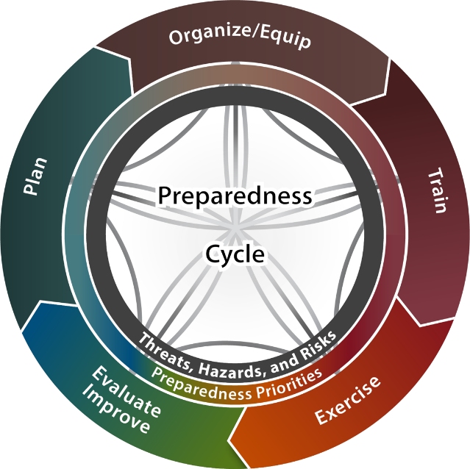
Integrated Preparedness Overview
The purpose of the Integrated Preparedness Plan (IPP) is to document overall preparedness priorities and activities for [jurisdiction/organization].
Incorporating all elements of the Integrated Preparedness Cycle allows for maximum efficiency of resources, time, and funding.
This works towards improving [jurisdiction/organization] capabilities.
Sponsor Logo

Slide 7
Integrated Preparedness Overview
Utilizing the Integrated Preparedness Cycle when developing the Integrated Preparedness Plan, provides a jurisdiction/organization a continuous and reliable approach for examining the progress of improvement toward the ability to prepare for, respond to, recover from, and mitigate the threats, hazards, and risks most relevant to the jurisdiction/organization.

Slide 8
IPPW Purpose
The purpose of the IPPW is to consider the range of preparedness activities within the Integrated Preparedness Cycle, and along with the guidance provided by senior leaders, identify and set preparedness priorities, and schedule preparedness activities for the multi-year Integrated Preparedness Plan.

Slide 9
Review of Prior Integrated Preparedness Plan (IPP)
[Insert highlights from the previous multi-year IPP and an update on the progress toward the preparedness priorities and the multi-year schedule]

Slide 10
Workshop Activities (1/2)
The IPPW focuses on primary activities and associated tasks.
Identify Preparedness Priority Factors:
Identify threats, hazards, and risks
Identify validated and non-validated areas for improvement and capability assessments
Identify external sources and requirements
Identify accreditation standards or regulations
Establish Preparedness Priorities

Slide 11
Workshop Activities (2/2)
Develop a Multi-Year Schedule
Identify planning elements
Identify organization and equipment elements
Identify training opportunities
Identify potential exercises
Build multi-year schedule
Establish Program Reporting

Slide 12
Identify Preparedness Priority Factors
Identifying the applicable factors affecting jurisdiction/organization is the key element to then setting preparedness priorities
The list of factors is intended to help organizations consider the full range of factors impacting their preparedness activities for the coming multi-year schedule

Slide 13
Activity Overview
During this activity, we will focus on the following tasks:
Identify Threats, Hazards and Risks
Identify Areas for Improvement and Capabilities
Identify External Sources and Requirements
Identify Accreditation Standards and Regulations

Slide 14
Identify Threats, Hazards, and Risks
Objective: Identify any significant threats, hazards, and risks
Consider:
Jurisdiction/Organization threats and hazards
THIRA or other local risk assessments
Hazard vulnerability analysis
National threats and hazards
Instructions:
Locate the other members of your jurisdiction/organization
As a group, develop a list of the top threats, hazards, and risks impacting your jurisdiction/organization
Record these threats, hazards, and risks
Choose a group member to brief the findings

Slide 15
Identify Areas for Improvement and Capabilities Assessments
Objective: Identify areas for improvement and assess current capabilities
Consider:
Previous areas for improvement and capability assessments identified
Prioritized corrective actions
Newly acquired capabilities and resources
Completed corrective actions validated
Strengths shared
Instructions:
Locate the other members of your jurisdiction/organization
As a group, develop a list of your jurisdiction’s or organization’s top strengths and areas for improvement
Record these strengths/areas for improvement
Choose a group member to brief the findings

Slide 16
Identify External Sources and Requirements
Objective: Identify any significant external sources and requirements
Consider:
Industry reports
State or national preparedness reports
Homeland security strategies
Grants or funding-specific requirements
Instructions:
Locate the other members of your jurisdiction/organization
As a group, develop a list of your jurisdiction’s/organization’s key external sources and requirements
Record these sources and requirements
Choose a group member to brief the findings

Slide 17
Identify Accreditation Standards and Regulations
Objective: Identify any significant accreditation standards and regulations
Consider:
Accreditation requirements
Local, state, and federal regulations
Instructions:
Locate the other members of your jurisdiction/organization
As a group, develop a list of your jurisdiction’s/organization’s key accreditation standards and regulations
Record these standards and regulations
Choose a group member to brief the findings

Slide 18
Establish Preparedness Priorities
Preparedness priorities are the strategic, high-level priorities that guide overall preparedness activities
These priorities should be comprehensive to meet the needs of the whole community and will drive preparedness activities through the Integrated Preparedness Cycle

Slide 19
Establish Exercise Program Priorities
Objective: Achieve consensus on the priorities that will guide the preparedness activities for the next [#] years
Consider:
Factors identified in Activity 1
Senior Leaders’ guidance
Instructions:
Identify appropriate number of priorities on which to focus upcoming preparedness activities
Priorities should action orientated and measurable
Consider priorities from a holistic preparedness perspective

Slide 20
Develop a Multi-Year Schedule
The multi-year schedule outlines the preparedness activities that will address the preparedness priorities identified in Activity 2.
The purpose of this activity is to schedule and synchronize all aspects of preparedness within the Integrated Preparedness Cycle, not just training and exercises, in an effort to address capability gaps and improve overall preparedness.

Slide 21
Activity Overview
During this activity, we will focus on the following tasks:
Identify Planning Elements
Identify Organizational Structure Elements
Identify Equipment Elements
Identify Training Opportunities
Identify Potential Exercises
Update and Build Multi-Year Schedule

Slide 22
Identify Planning Elements
Objective: Identify planning activities affecting preparedness priorities
Consider:
Existing planning goals or deadlines
Existing corrective actions to be integrated into plans
Information needed on jurisdictional/organizational factors
Training needed for existing plans, policies, procedures, and checklists
Instructions:
Locate the other members of your jurisdiction/organization
As a group, discuss what plans, policies, procedures, and checklists will be reviewed, updated, or written in the next [# of years] years
Record the results of the discussion
Choose a group member to brief the findings

Slide 23
Identify Organizational Structure Elements
Objective: Identify organization activities affecting preparedness priorities
Consider:
New organizational structure changes, shortfalls, and limiting factors
Upcoming budget, grants, retirements, staff turnover, long term vacancies
Training needed to address organizational structure and capabilities changes
Instructions:
Locate the other members of your jurisdiction/organization
As a group, discuss jurisdiction/organization structure changes for the next [# of years] years
Record results of the discussion
Choose a group member to brief the findings

Slide 24
Identify Equipment Elements
Objective: Identify equipment activities affecting preparedness priorities
Consider:
New equipment, shortfalls, and limiting factors
Upcoming budget, grants, purchase approvals,
Training needed to improve or introduce equipment capabilities
Instructions:
Locate the other members of your jurisdiction/organization
As a group, discuss equipment changes for the next [# of years] years
Record results of the discussion
Choose a group member to brief the findings

Slide 25
Identify Potential Training
Objective: Identify potential training priorities and opportunities for inclusion in the multi-year schedule
Consider:
Current training capabilities and planned courses
Jurisdictional/Organizational customized training
Recurring training requirements
Training needed to close gaps
Training needs prior to exercises
Training options available
Instructions:
Locate the other members of your jurisdiction/organization
As a group, identify potential training events
Record the potential training events, including the focus, audience, and date
Choose a group member to brief the findings

Slide 26
Identify Potential Exercises
Objective: As a group, identify potential exercises for inclusion in the multi-year schedule
Consider:
What changes to plans, policies, procedures, and checklists need validating?
What jurisdictions/organizations, departments, and teams need exercising and in what way?
Does equipment usage need validating?
What training is needed prior to exercising? Identify training.
What previous corrective actions need to be validated?
What types of exercises will meet needs?
What is the goal or intended outcome of the chosen exercises?
Instructions:
Locate the other members of your jurisdiction/organization
As a group, identify potential exercises
Record the potential exercises events, including the focus, audience, and date
Choose a group member to brief the findings.

Slide 27
Update/Build the Multi-Year Schedule
Objective: Update or build the multi-year schedule of preparedness activities
Consider:
Preparedness factors identified in previous tasks (plan, organize/equip, train, exercise, and improve)
Activities that promote collaboration
Activities involving the Whole Community
Instructions:
Populate planning activities identified
Select organize/equip activities identified to populate in the multi-year schedule
Select exercises from the proposed list and identify tentative exercise conduct dates
Select training events and identify tentative conduct dates, scheduling around planning, organize/equip, and exercises, as appropriate

Slide 28
Integrated Preparedness Schedule
[Month 1]
Activity | Priority 1 | Priority 2 | Priority 3 | Priority 4 | Priority 5
Plan
Organize
Equip
Train
Exercise
Example schedule only

Slide 29
Integrated Preparedness Schedule
[Month 2]
Activity | Priority 1 | Priority 2 | Priority 3 | Priority 4 | Priority 5
Plan
Organize
Equip
Train
Exercise
Example schedule only

Slide 30
Integrated Preparedness Schedule
[Month 3]
Activity | Priority 1 | Priority 2 | Priority 3 | Priority 4 | Priority 5
Plan
Organize
Equip
Train
Exercise
Example schedule only

Slide 31
Establish Program Reporting
Include the jurisdiction’s/organization’s methodology for prioritizing, assigning, monitoring, tracking, and reporting the progress made toward resolution of issues identified during exercises and real-world incidents, as well as, capability improvement projects and the overall impact these actions have on capabilities.

Slide 32
Establish Program Reporting
Consider:
Compiling and recording areas for improvement from exercises and real-world incidents
Determining actions and linking capabilities needed to address identified areas for improvement and associated corrective actions
Prioritizing, assigning, tracking, reporting, and updating corrective actions progress
Incorporating changes, completed corrective actions, identified potential best practices and lessons learned into future iterations of the Integrated Preparedness Cycle and IPP

Slide 33
Review
Ensure proposed preparedness activities support and address the preparedness priorities.
Collaborate and coordinate with stakeholders to reduce overlap and to share resources.

Slide 34
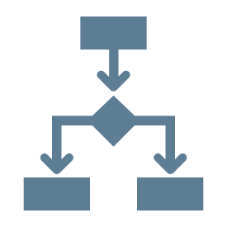
Next Steps
Develop and distribute IPPW Summary
Develop the IPP
[insert additional items as needed]

Slide 35
Conclusion
Sponsor Logo

